Slide 1
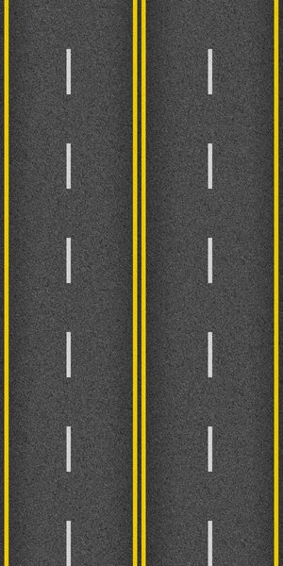


Slide 2

Flight Exploratory Data Analysis (EDA)
- April 2023 -

Slide 3
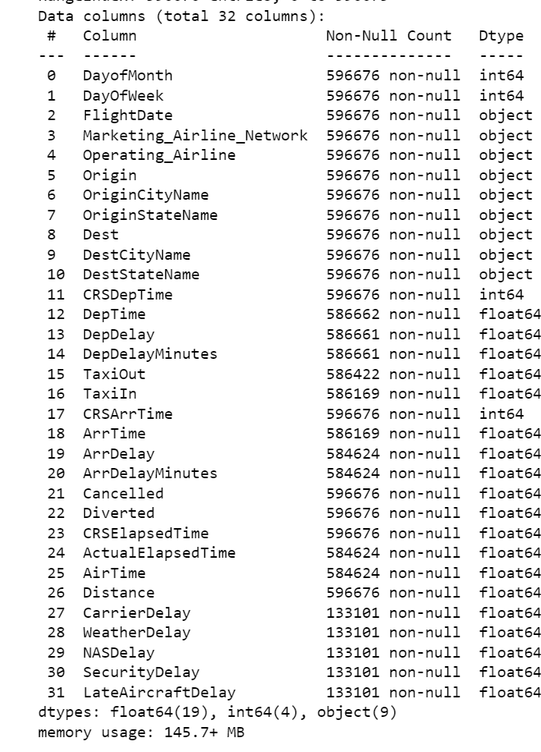

- General information
1
Data Source : Bureau of Transportation Statistics
2
Data Date : April 2023
3
Data Info :

Slide 4
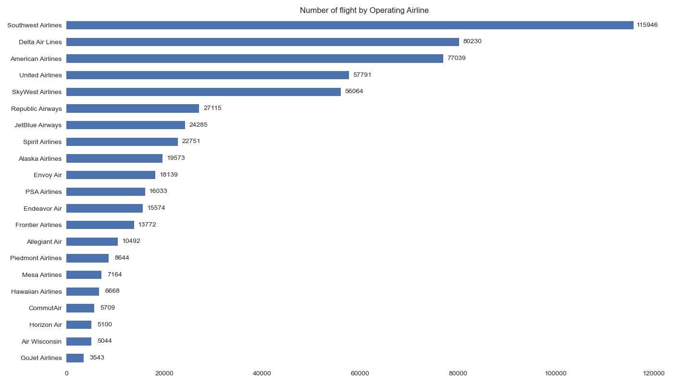

Number of Flight by Operating Airline

Slide 5
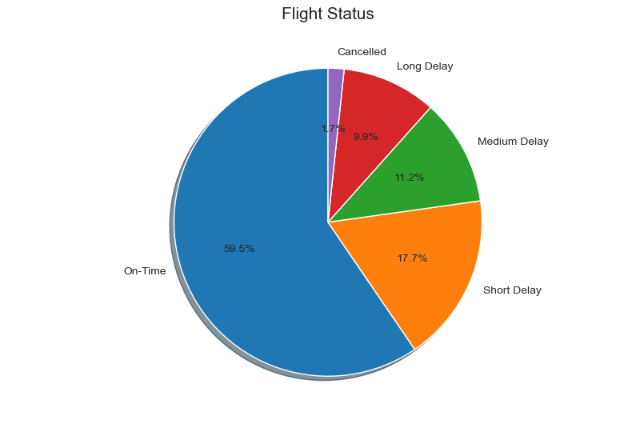

Percentage of in each statue

Slide 6
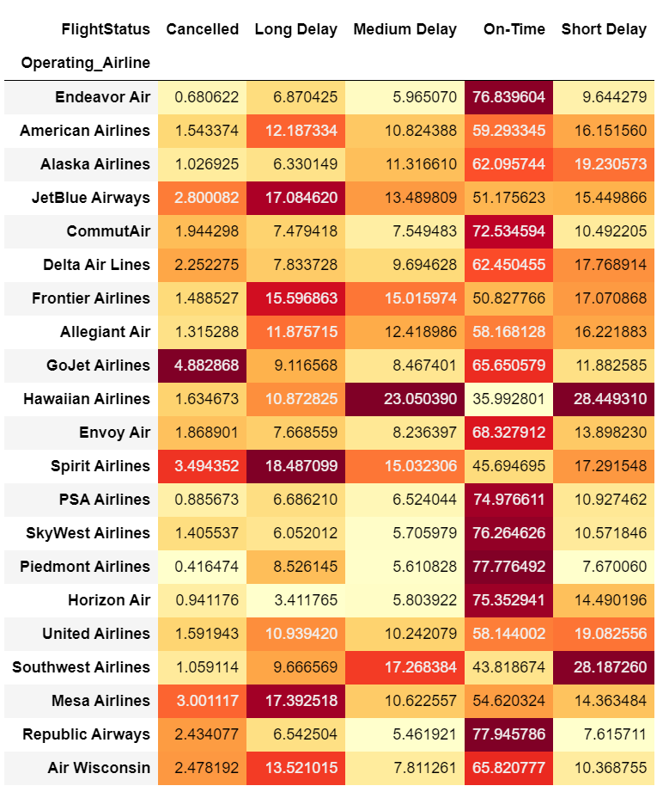
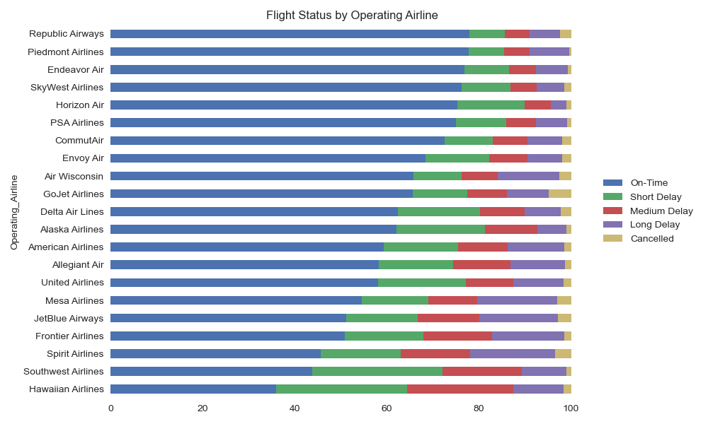

Flight Status by Operating Airline

Slide 7
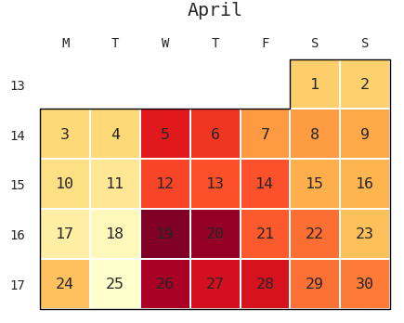

Delay flight by days of April

Slide 8
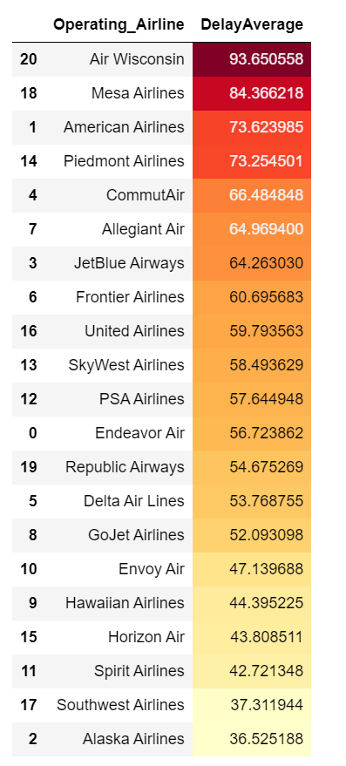


Analyzing Flight Delay (medium and long)
The average delay for each operating airline based on the total delay and the count of flights.
1

Slide 9


Weather Delay by the Origin of the Flight

Slide 10
